Slide 1



Journey PPT
Tanishqa Aggarwal
28 Aug 2023 - 01 Sep 2023
Week 2

Slide 2

Day 1
28 Aug 2023
Case Study Assessment
We implemented a CI/CD Workflow for a Spring Boot Application using Azure Boards, Azure, Git, Maven, Docker, Github, Github Actions.
Activities
Project Management Setup
GitHub Repository and Feature Branching
Azure VM Configuration
Maven-Based Build Process
Prometheus Monitoring Integration
Docker Containerization
Azure Web App Configuration
Pull Request Collaboration
GitHub Actions Workflow Implementation
Local Testing of Azure Web App
Azure Boards Task and Sprint Closure
Project Closure and Reflection

Slide 3





Day 2
29 Aug 2023
Normalisation
Entity-Relationship Dioagram
OLAP
Normalization is a process in database design that involves organizing data in a structured and efficient way to reduce data redundancy and improve data integrity.
The most commonly used normal forms are:
First Normal Form (1NF)
Second Normal Form (2NF)
Third Normal Form (3NF)
OLAP stands for Online Analytical Processing. It is a category of software tools and techniques used to perform complex and interactive analysis of multidimensional data from different perspectives. OLAP systems are designed to help users explore and analyze large volumes of data in a flexible and intuitive manner.
Database Management System
An Entity-Relationship Diagram (ERD) is a visual representation of the logical structure of a database system, illustrating the relationships among different entities (objects or concepts) within the system.
OLTP
OLTP stands for Online Transaction Processing. It refers to a type of computing and database architecture designed to efficiently manage and process a high volume of transactional data in real-time.
A Database Management System (DBMS) is a software system designed to manage, store, retrieve, and manipulate data efficiently and securely.

Slide 4
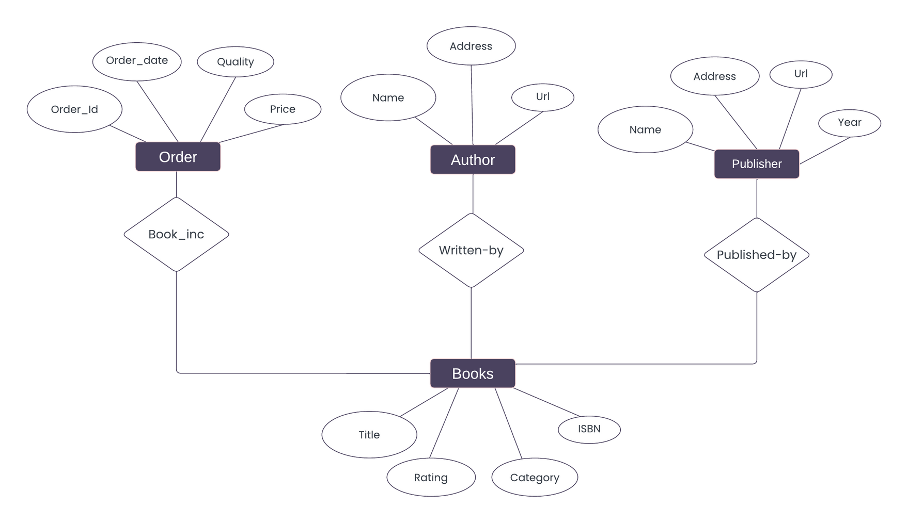
Day 2
29 Aug 2023
Books Entity Relationship Diagram

Slide 5
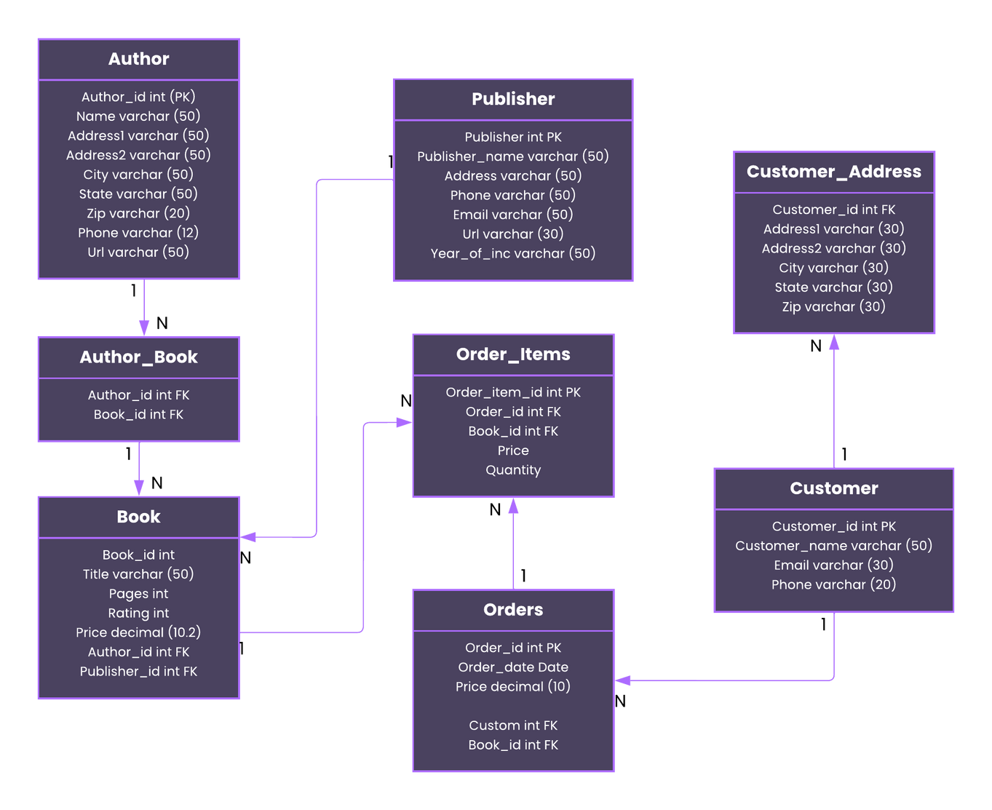
Day 2
29 Aug 2023
Schema Diagram

Slide 6



Day 3
30 Aug 2023
Star Schema
Data Warehouse
A "star schema" is a type of data modeling technique used in data warehousing and business intelligence (BI) systems.
A data warehouse is a centralized repository that stores large volumes of structured, historical data and makes it available for querying and analysis.
Snowflake Schema
Data Mart
It is another type of data modeling technique similar to the star schema. However, the snowflake schema differs in how it structures dimension tables.
A data mart is a subset of a data warehouse that is focused on a specific subject area or department within an organization.
Big Data
Data Lake
"Big data" refers to extremely large and complex datasets that cannot be easily managed, processed, or analyzed using traditional data processing tools or methods.
A data lake is a centralized repository that allows organizations to store a vast amount of structured, semi-structured, and unstructured data at scale.

Slide 7
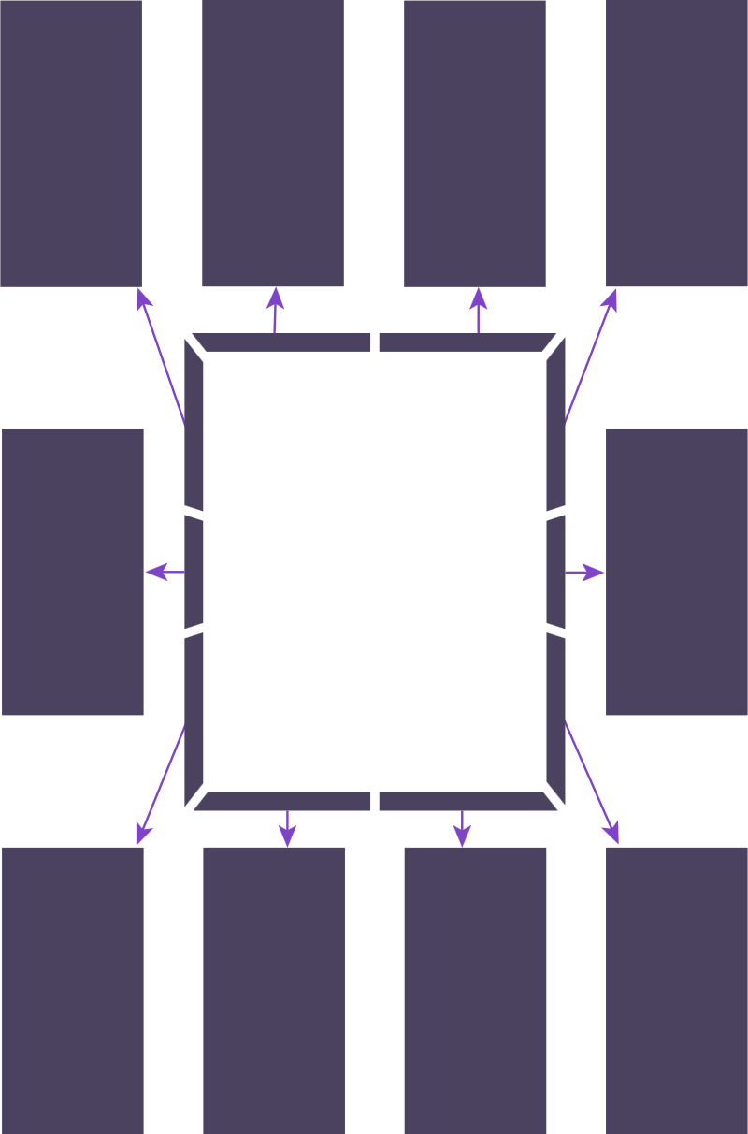
Flume & Kafka
Hadoop Distributed File System (HDFS)
Day 3
30 Aug 2023
MapReduce
HADOOP
Yet Another Resource Negotiation (YARN)
Oozie
Hadoop is an open-source framework for distributed storage and processing of large datasets. It was designed to handle big data, which typically includes massive volumes of data that cannot be easily managed or processed using traditional database systems.
Apache Spark
Scoop
Pig
HBase
Hive

Slide 8
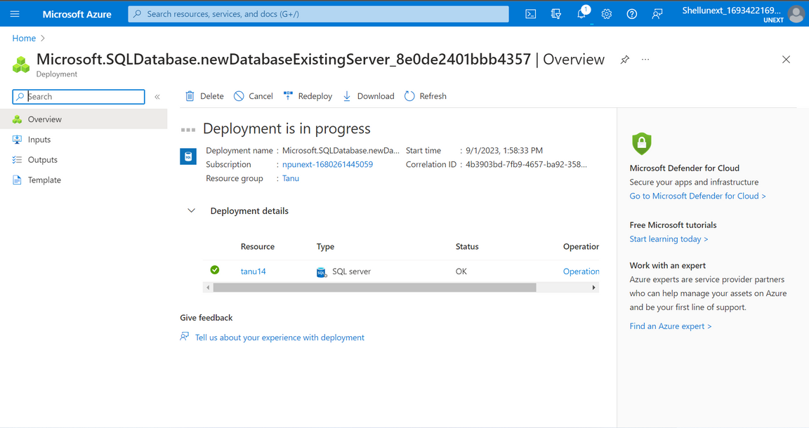
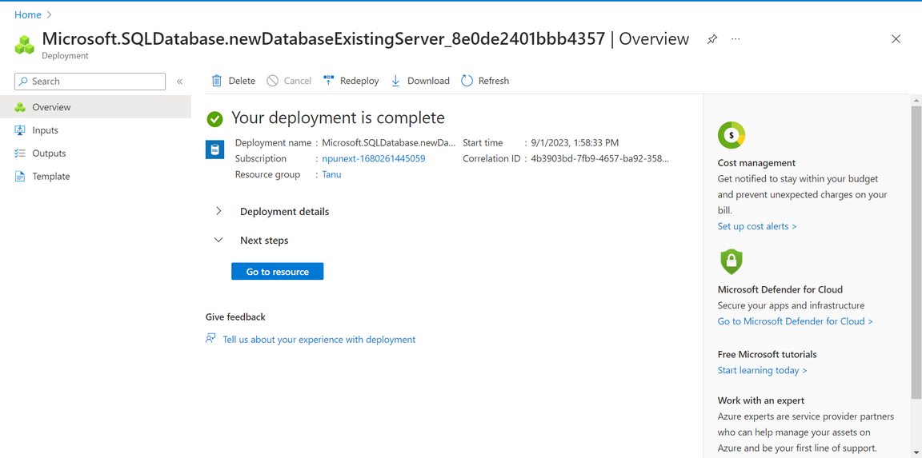
Day 4
31 Aug 2023
Azure SQL Database
Deploying Azure Sql Database

Slide 9
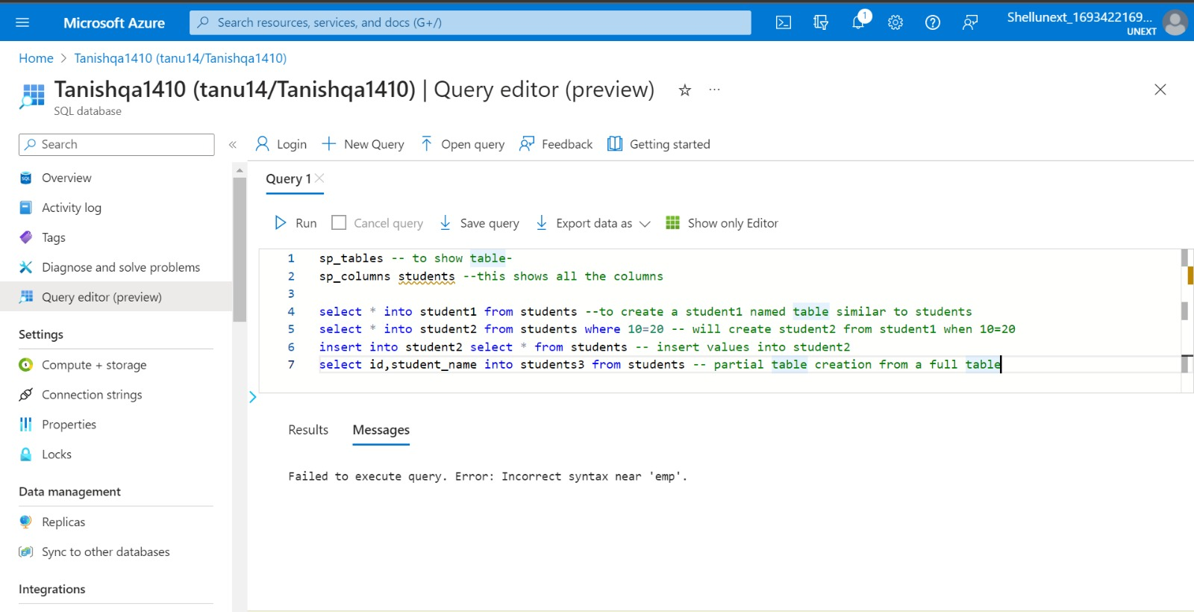
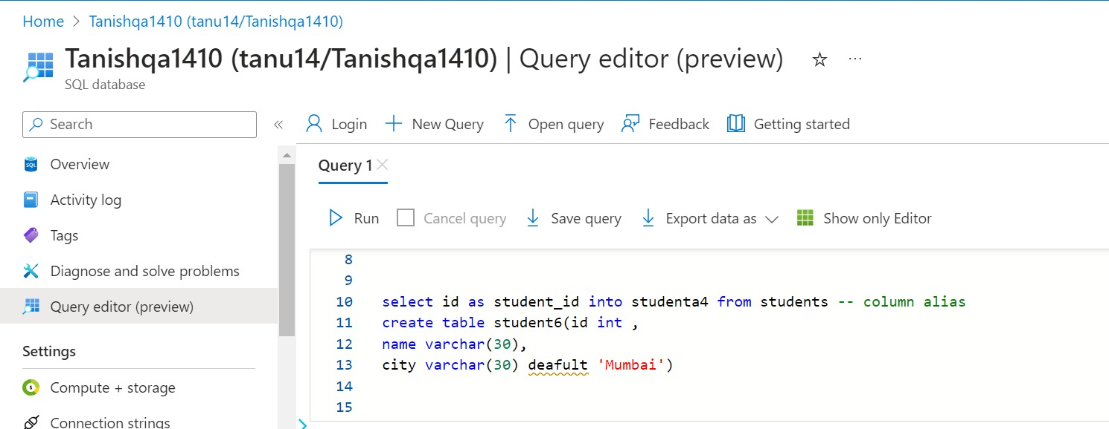
Day 4
31 Aug 2023
Sql Commands

Slide 10
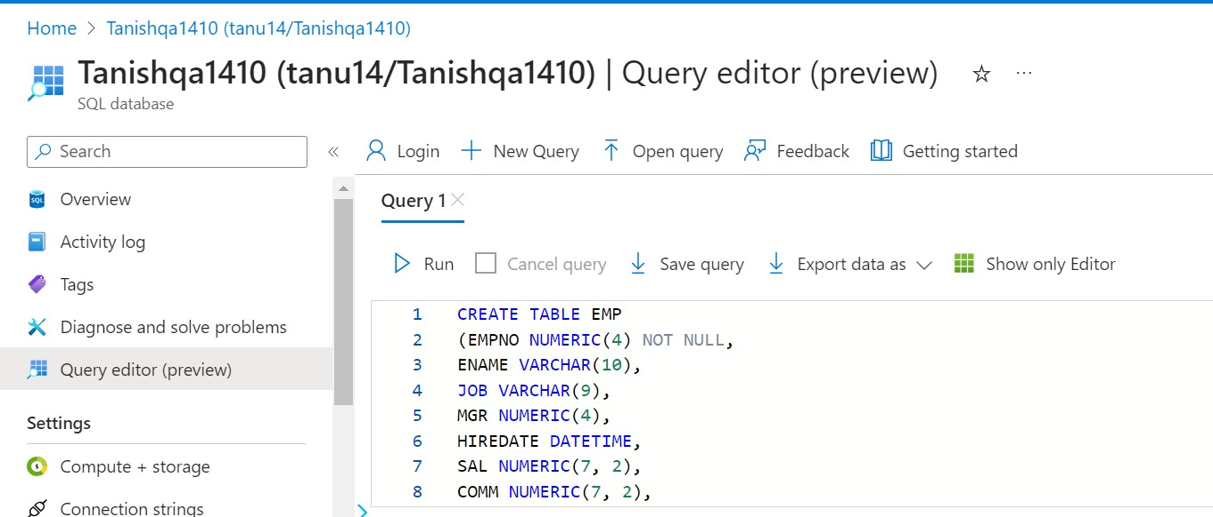
Day 5
1 Sep 2023
Sql Commands

Slide 11
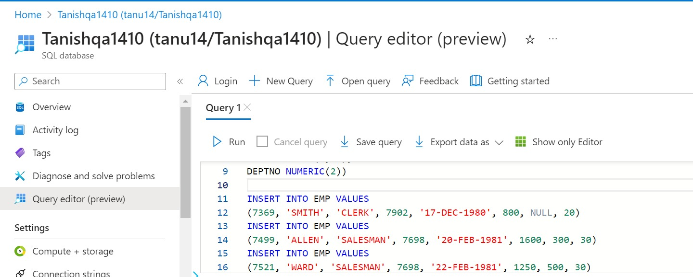
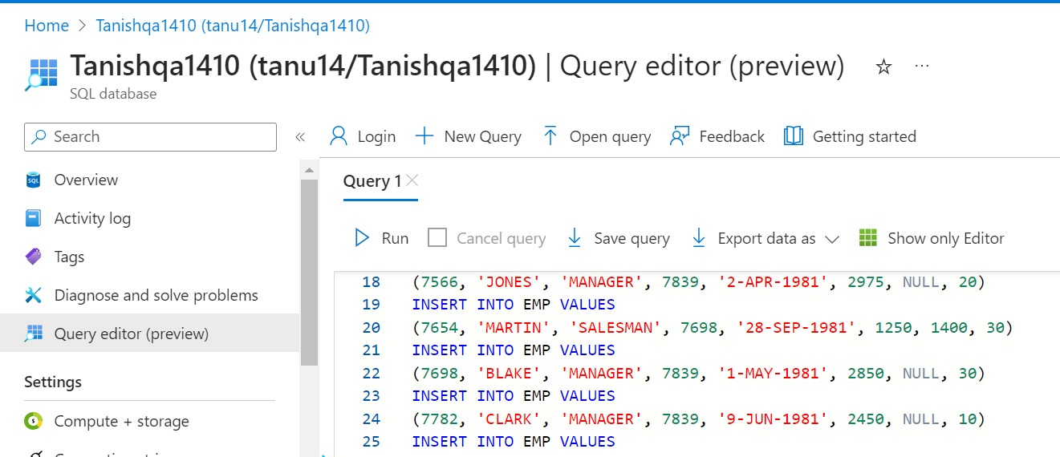
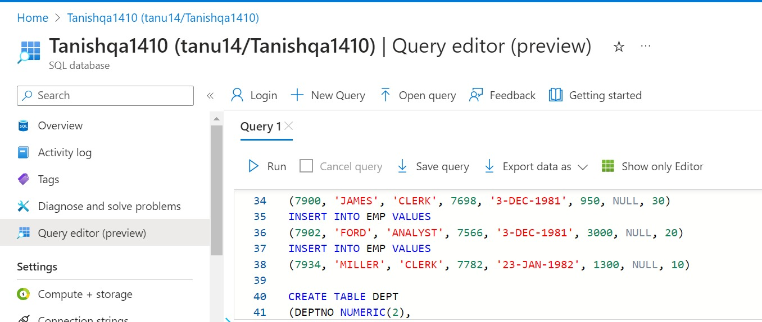
Day 5
1 Sep 2023
Sql Commands

Slide 12
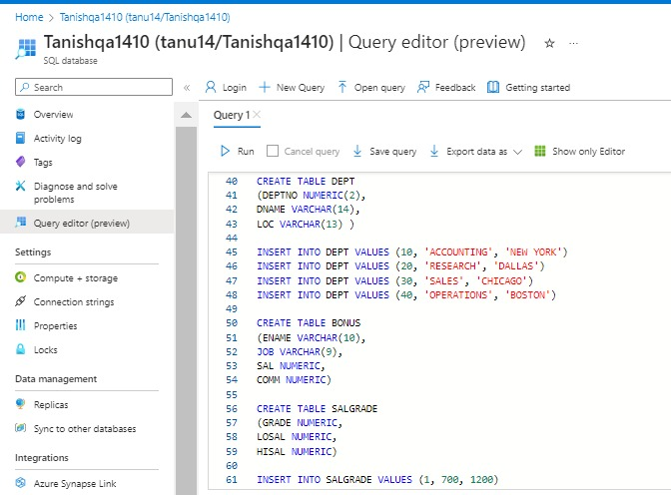
Day 5
1 Sep 2023
Sql Commands

Slide 13
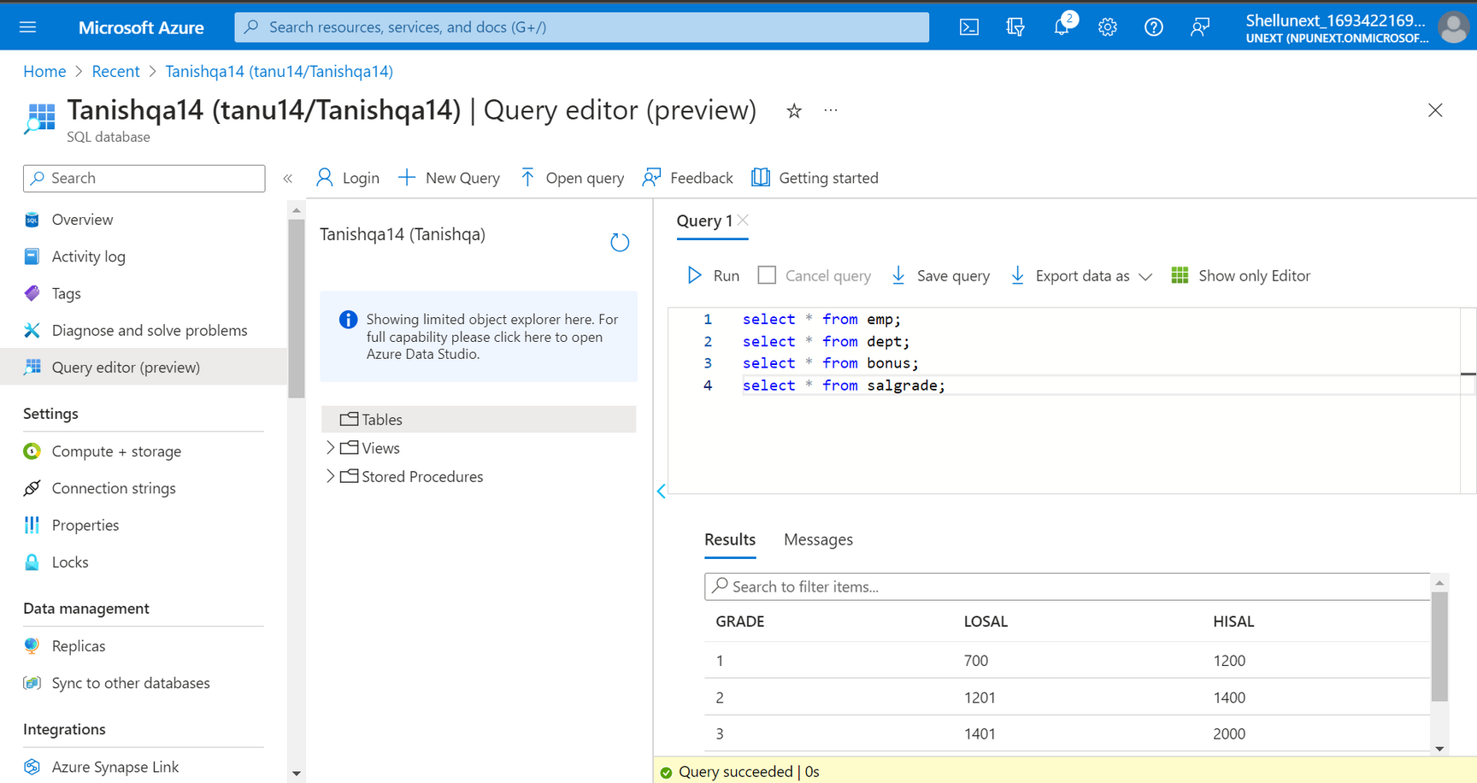
Day 5
1 Sep 2023
Sql Commands

Slide 14

Thank You

